Slide 1


K.RAMAKRISHNAN COLLEGE OF TECHNOLOGY
(AUTONOMOUS), TRICHY
DEPARTMENT OF ARTIFICIAL INTELLIGENCE AND DATA SCIENCE
AGB1303-AI PROBLEM SOLVING TECHNIQUES
PRESENTED BY
GEETHAN K - 2403811724321026
DHIVIN M - 2403811724321020
HARIHARAVASAN V -2403811724321029
HARIHARINI R -2403811724322030
GUIDED BY
Ms. ADEEBA AAISHA F
TA /AIDS

Slide 2
TRUTHSENSE AI: A CONTEXT-AWARE FAKE NEWS DETECTION FRAMEWORK USING ARTIFICIAL INTELLIGENCE
TOPIC

Slide 3
PRESENTATION OVERVIEW
Abstract
Objective
Architecture diagram
Literature Survey
Research Methodology
Existing system
Proposed system
Conclusion
Future enhancement

Slide 4
ABSTRACT
TruthSense AI is an AI-based system for detecting fake news.
It uses Machine Learning and Natural Language Processing (NLP).
The system analyzes news content to identify fake or real information.
It provides fast and accurate detection results.
It helps reduce the spread of misinformation.
The system improves user trust through reliable predictions.
It supports users in identifying trustworthy news.

Slide 5
OBJECTIVE
Detect fake news automatically using AI.
Reduce the spread of misinformation.
Improve prediction accuracy using Machine Learning.
Provide explainable results using Explainable AI (XAI).
Support users in making informed decisions.
Build a scalable and real-time fake news verification system.

Slide 6
LITERATURE SURVEY
https://docs.google.com/spreadsheets/d/1tdvZ6scOht_aZ4ScR0ofBAgpTPbIFu6H/edit?gid=1237255902#gid=1237255902

Slide 7
RESEARCH METHODOLOGY
1.Data Collection and Preprocessing
Collect real and fake news articles from reliable datasets and news sources.
Clean the data by removing duplicates, URLs, special characters, and irrelevant content.
Perform tokenization, stop-word removal, and lemmatization.
2.Feature Extraction
Extract textual features such as keywords, word frequency, sentiment, and linguistic patterns.
Extract contextual features such as source credibility, publication date, and related information.
Convert text into numerical representations using TF-IDF or Transformer embeddings.
3.AI Model Development
Train machine-learning/deep-learning models such as SVM, Random Forest, LSTM, or BERT.
Combine textual and contextual features for improved fake news detection.
Classify news as real, fake, or suspicious.

Slide 8
RESEARCH METHODOLOGY
4.Model Training and Evaluation
Divide the dataset into training, validation, and testing sets.
Train and optimize the selected AI models.
Evaluate performance using accuracy, precision, recall, F1-score, and confusion matrix.
5.Framework Implementation and Validation
Develop the TruthSense AI system to accept news content as input.
Generate a prediction with a confidence score and contextual explanation.
Validate the system using unseen news samples and analyze its effectiveness.

Slide 9
EXISTING SYSTEM
Manual fact-checking process.
Time-consuming and expensive.
Depends on human experts.
Cannot detect fake news in real time.
Lower efficiency for large datasets.
Disadvantages:
Slow verification.
Human errors.
High operational cost.
Delayed response.

Slide 10
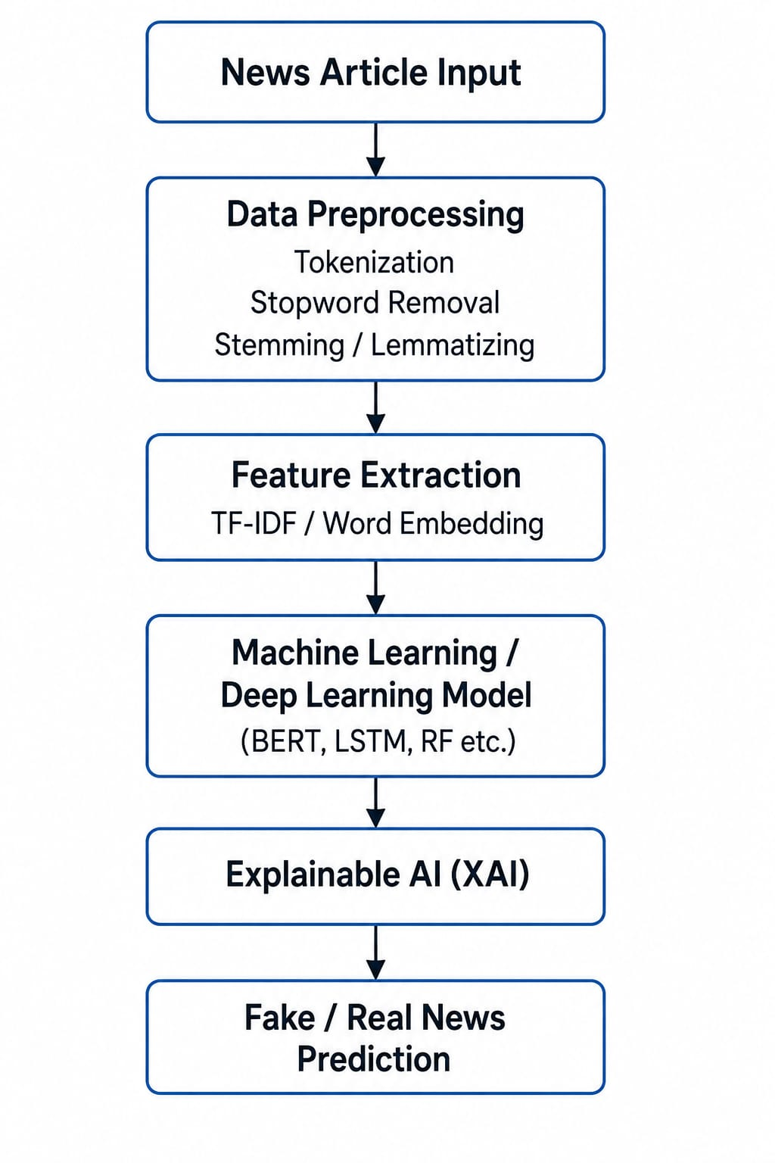
ARCHITECTURE DIAGRAM

Slide 11
PROPOSED SYSTEM
TruthSense AI uses NLP, Machine Learning, and Explainable AI to detect fake news automatically.
Features
AI-based fake news classification.
NLP-based text analysis.
Real-time prediction.
Explainable AI for transparency.
High accuracy.
Scalable framework.

Slide 12
CONCLUSION
Detects fake news using Artificial Intelligence.
Improves the accuracy of news verification.
Reduces the spread of misinformation.
Provides explainable and understandable predictions.
Enhances user trust in online information.
Supports media organizations and educational institutions.
Promotes authentic and reliable information sharing.
Notes:
12

Slide 13
FUTURE ENHANCEMENT
Multilingual fake news detection.
Image and video misinformation detection.
Social media sentiment analysis.
Integration with browser extensions.
Mobile application support.
Real-time online news verification.
Hybrid AI models for improved accuracy.

Slide 14
THANK YOU

